Slide 2
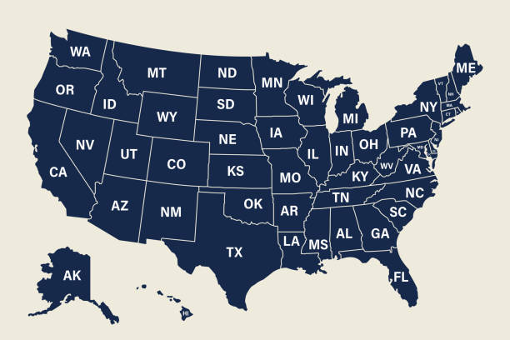
EDA Scope, Objectives and Focus
Scope: To perform a root-cause analysis of motor vehicle-related fatalities and identify contributing factors and conditions
Objectives:
Provide insights that can improve roadway safety by identifying high-risk conditions pertaining to weather, road construction, signage
Identify lag times between crash notification and EMS/EMT arrival, and EMS/EMT lag times from crash sites to medical treatment facilities
Analysis Focus: Selection of 8 states for the years 2022 and 2023 - Alaska, California, District of Columbia, Florida, Georgia, Rhode Island, Texas, Vermont

Slide 3
Primary Data Sources: US DOT Bureau of Transportation Statistics Fatality Analysis Reporting System, years 2022 and 2023. These datasets are subsets of the U.S. Department of Transportation (USDOT)/Bureau of Transportation Statistics (BTS) National Transportation Atlas Database (NTAD):
NTAD_Fatality_Analysis_Reporting_System_2022_Accident
NTAD_Fatality_Analysis_Reporting_System_2023_Accident
Input File Format and Data Structures
Both files are in .csv format
2022 file: 39,681 rows x 80 columns
2023 file: 37,951 rows x 80 columns
Data Limitations:
Florida’s data contained a high proportion of missing, unknown or unreported values across most attribures, which limited its suitability for analysis. The underlying cause of these omissions – whether due to state policy or other factors – could not be determined.
Because the accident datasets used in this analysis are subsets of the National Transportation Atlas Database(NTAD) more than 50 attributes were excluded, thereby limiting the scope of the EMT/EMS-related analyses.

Slide 4
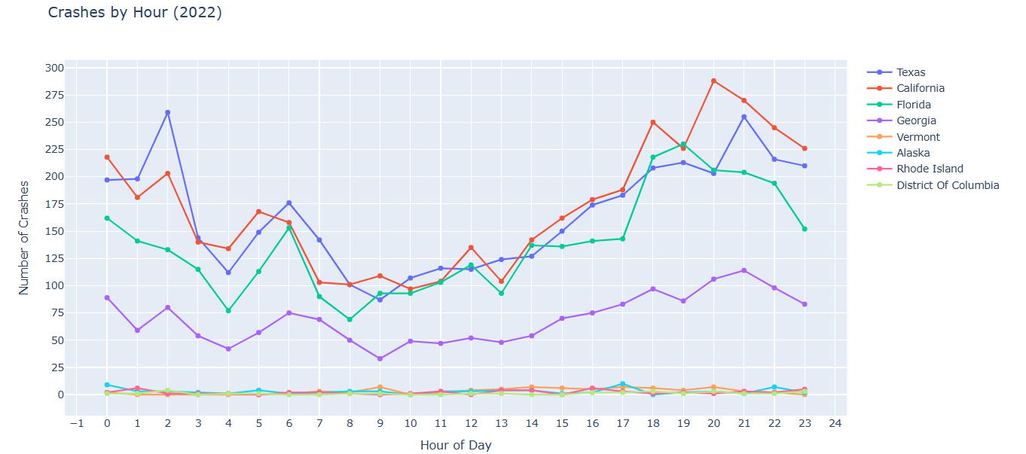
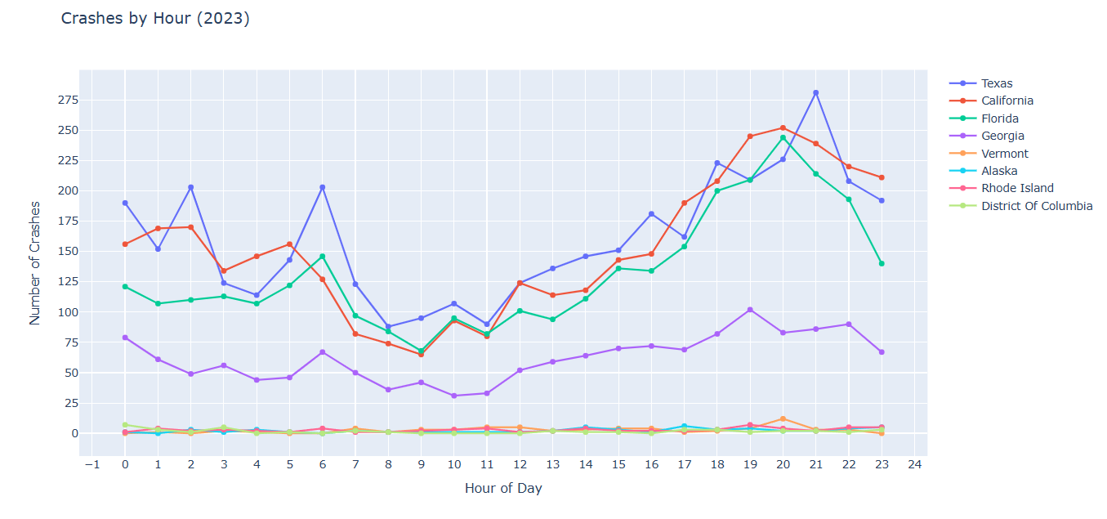
Accident Patterns by Time-of-Day Analysis

Slide 5

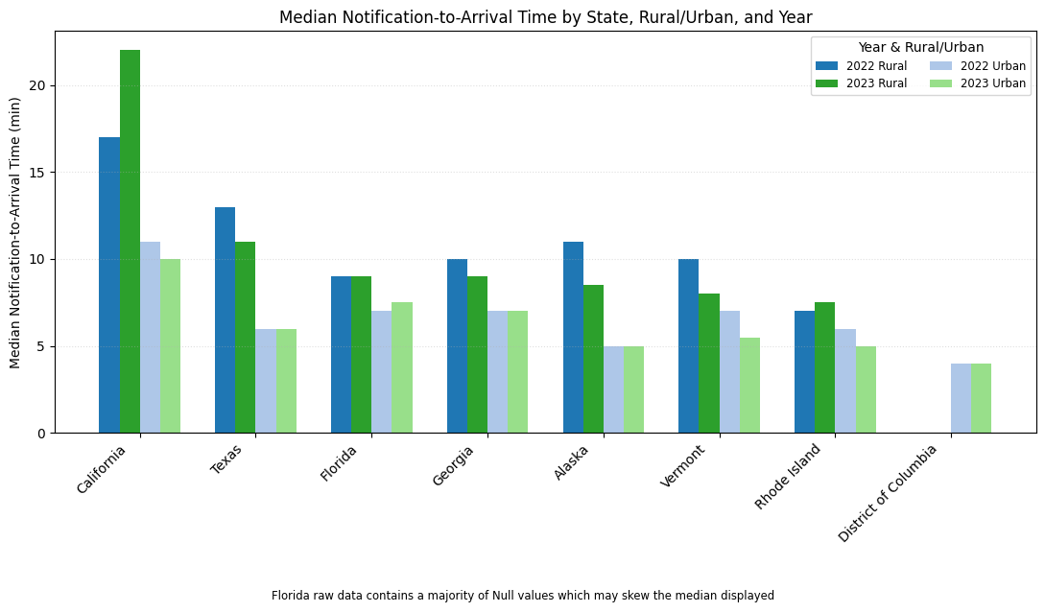
Median Notification of MVA Crash to EMS/EMT Lag-Time, Rural vs Urban

Slide 6
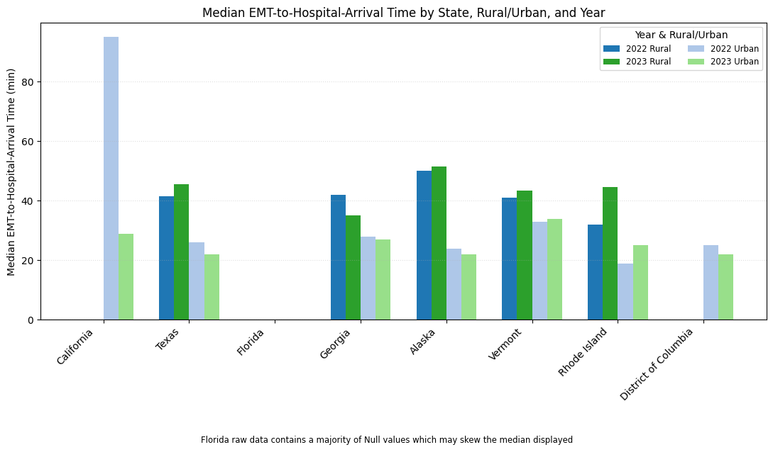
Median EMS/EMT Transit Time to Hospital, Rural vs Urban

Slide 7
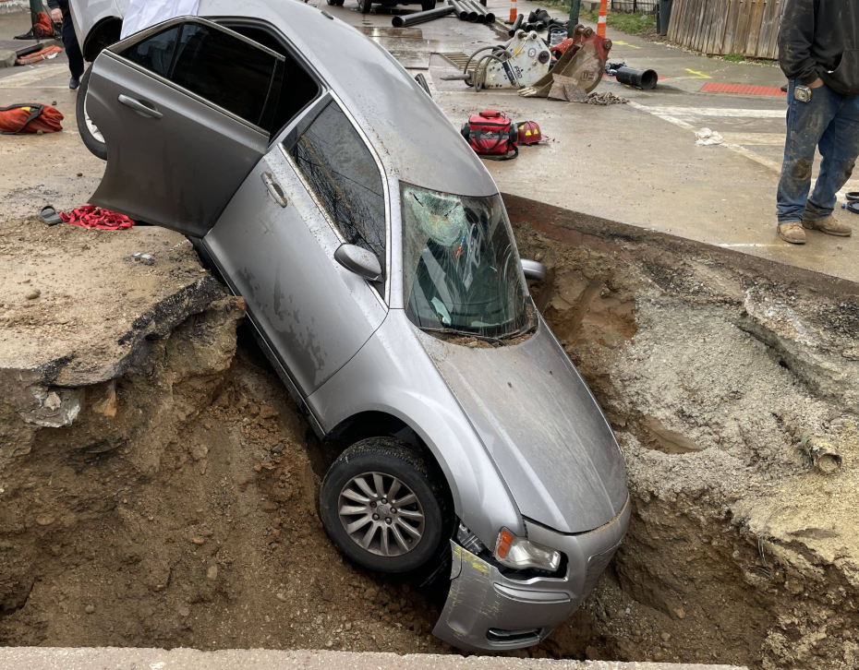
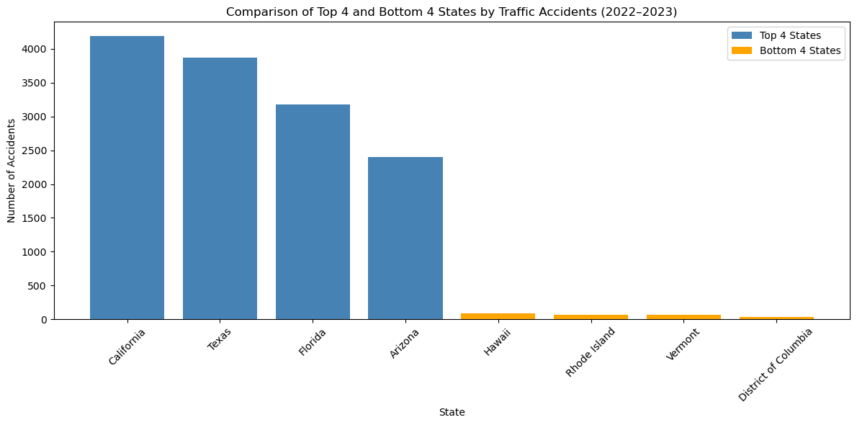
Construction Zone Analysis

Slide 8
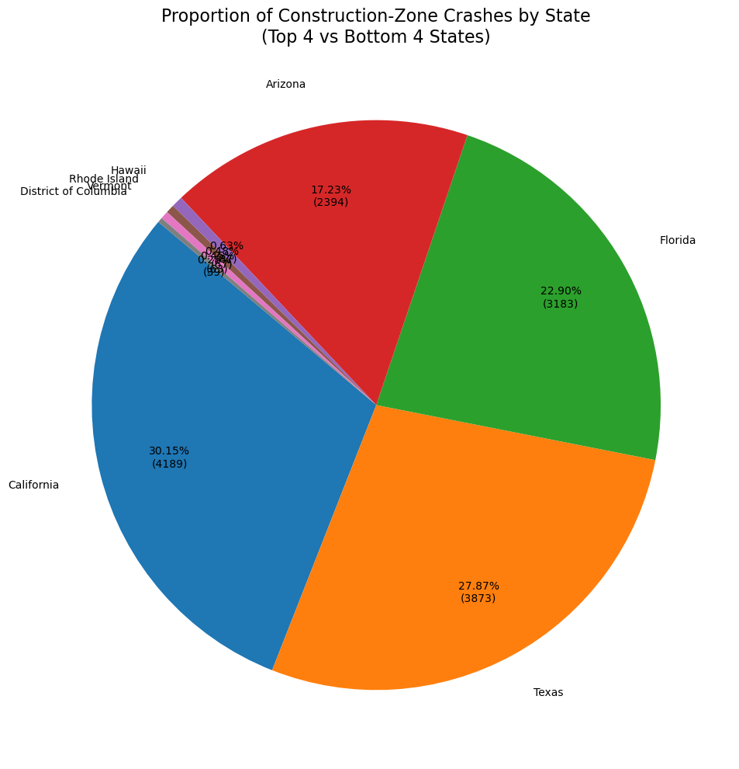
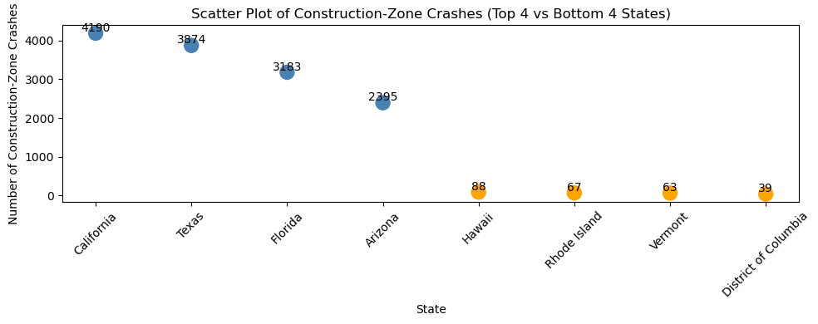
Construction Zone Analysis

Slide 9
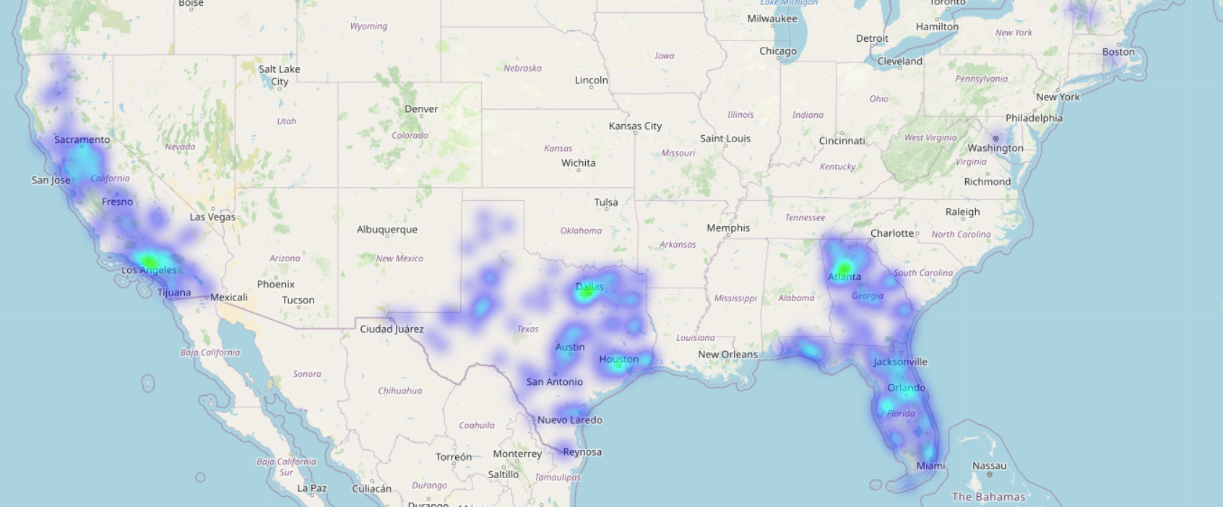
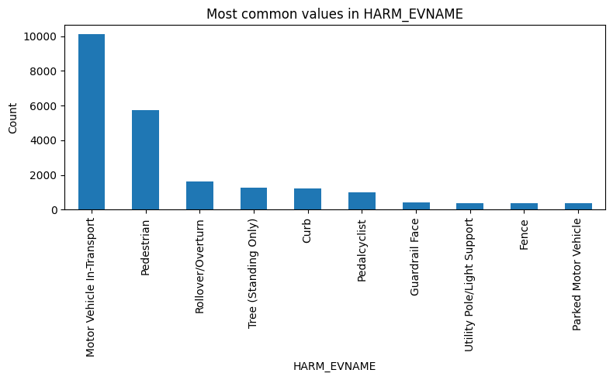
Types of Harm Analysis

Slide 10
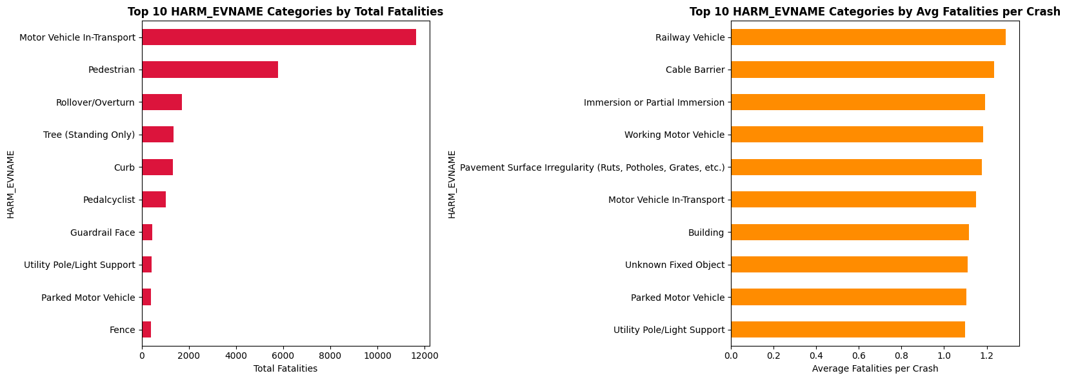
Types of Harm Analysis

Slide 11
CONCLUSION:
This analysis identified time‑of‑day risk patterns, rural‑urban disparities in EMS response times, types of harm and roadway conditions associated with fatal motor vehicle crashes. While data limitations constrained EMT/EMS analyses, the results provide valuable insights to support roadway safety improvements and highlight areas for enhanced data reporting and future research.

